Slide 1
Day 26: React Redux Fundamentals

Slide 2
Agenda
Use of React Redux
Redux Architecture
Redux Installation
Redux Concepts
Data Flow
Redux State
Hands-on exercises
Day 27: Redux Integration
Integrating Redux with a UI
Async Logic and Data Fetching
Standard Redux Patterns
Day 28: Moder Redux
Modern Redux with redux toolkit
Redux middleware
Redux thunk
createSlice
UseReducer
Hands-on exercises

Slide 3
Use of React Redux
To integrate Redux with your React application, especially when managing state across multiple components in a large-scale application, Redux simplifies the state management process.
Why Use Redux?
Centralized State Management: Redux stores the state of your application in a single place, which allows multiple components to access and update the state without the need for prop drilling.
Predictable State Changes: The state can only be updated through actions, and reducers handle the logic of how state updates occur.
Debugging and Dev Tools: Redux DevTools allows you to track all changes to the state over time, making it easier to debug.

Slide 4
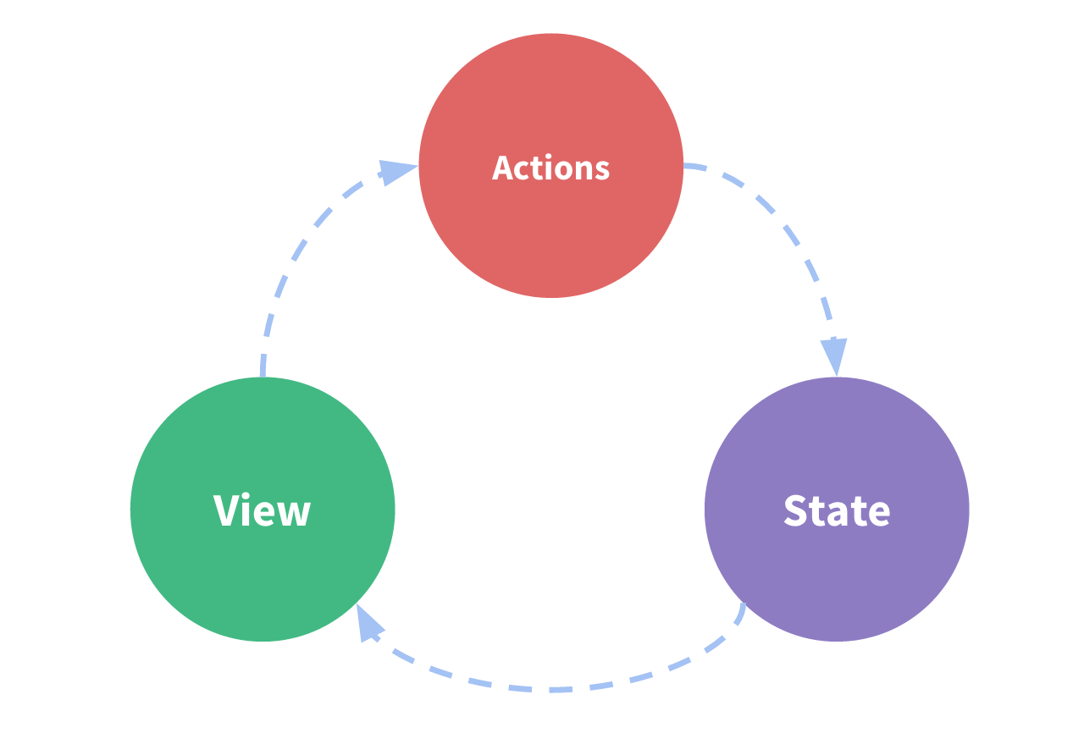
Redux Architecture
Redux Terminology​
There's some important Redux terms that you'll need to be familiar with before we continue:

Slide 5
Actions
An action is a plain JavaScript object that has a type field. You can think of an action as an event that describes something that happened in the application.
The type field should be a string that gives this action a descriptive name, like "todos/todoAdded". We usually write that type string like "domain/eventName", where the first part is the feature or category that this action belongs to, and the second part is the specific thing that happened.
An action object can have other fields with additional information about what happened. By convention, we put that information in a field called payload.
A typical action object might look like this:
const addTodoAction = {
type: 'todos/todoAdded',
payload: 'Buy milk'
}

Slide 6
Reducers
A reducer is a function that receives the current state and an action object, decides how to update the state if necessary, and returns the new state: (state, action) => newState. You can think of a reducer as an event listener which handles events based on the received action (event) type.
info
"Reducer" functions get their name because they're similar to the kind of callback function you pass to the Array.reduce() method.
Reducers must always follow some specific rules:
They should only calculate the new state value based on the state and action arguments
They are not allowed to modify the existing state. Instead, they must make immutable updates, by copying the existing state and making changes to the copied values.
They must not do any asynchronous logic, calculate random values, or cause other "side effects"

Slide 7
Reducers
The logic inside reducer functions typically follows the same series of steps:
Check to see if the reducer cares about this action
If so, make a copy of the state, update the copy with new values, and return it
Otherwise, return the existing state unchanged
Here's a small example of a reducer, showing the steps that each reducer should follow:
const initialState = { value: 0 }
function counterReducer(state = initialState, action) {
// Check to see if the reducer cares about this action
if (action.type === 'counter/incremented') {
// If so, make a copy of `state`
return {
...state,
// and update the copy with the new value
value: state.value + 1
}
} // otherwise return the existing state unchanged
return state}

Slide 9
Redux Application Data Flow​
"one-way data flow", which describes this sequence of steps to update the app:
State describes the condition of the app at a specific point in time
The UI is rendered based on that state
When something happens (such as a user clicking a button), the state is updated based on what occurred
The UI re-renders based on the new state
For Redux specifically, we can break these steps into more detail:
Initial setup:
A Redux store is created using a root reducer function
The store calls the root reducer once, and saves the return value as its initial state
When the UI is first rendered, UI components access the current state of the Redux store, and use that data to decide what to render. They also subscribe to any future store updates so they can know if the state has changed.
Updates:
Something happens in the app, such as a user clicking a button
The app code dispatches an action to the Redux store, like dispatch({type: 'counter/incremented'})
The store runs the reducer function again with the previous state and the current action, and saves the return value as the new state
The store notifies all parts of the UI that are subscribed that the store has been updated
Each UI component that needs data from the store checks to see if the parts of the state they need have changed.
Each component that sees its data has changed forces a re-render with the new data, so it can update what's shown on the screen

Slide 10
Reducers
Reducers can use any kind of logic inside to decide what the new state should be: if/else, switch, loops, and so on.
Detailed Explanation: Why Are They Called 'Reducers?'
The Array.reduce() method lets you take an array of values, process each item in the array one at a time, and return a single final result. You can think of it as "reducing the array down to one value".
Array.reduce() takes a callback function as an argument, which will be called one time for each item in the array. It takes two arguments:
previousResult, the value that your callback returned last time
currentItem, the current item in the array
The first time that the callback runs, there isn't a previousResult available, so we need to also pass in an initial value that will be used as the first previousResult.
If we wanted to add together an array of numbers to find out what the total is, we could write a reduce callback that looks like this:

Slide 11
Reducers
Notice that this addNumbers "reduce callback" function doesn't need to keep track of anything itself. It takes the previousResult and currentItem arguments, does something with them, and returns a new result value.
A Redux reducer function is exactly the same idea as this "reduce callback" function! It takes a "previous result" (the state), and the "current item" (the action object), decides a new state value based on those arguments, and returns that new state.
If we were to create an array of Redux actions, call reduce(), and pass in a reducer function, we'd get a final result the same way:
const numbers = [2, 5, 8]
const addNumbers = (previousResult, currentItem) => {
console.log({ previousResult, currentItem })
return previousResult + currentItem
}
const initialValue = 0
const total = numbers.reduce(addNumbers, initialValue)
// {previousResult: 0, currentItem: 2}
// {previousResult: 2, currentItem: 5}
// {previousResult: 7, currentItem: 8}
console.log(total)
// 15

Slide 12
Reducers
const actions = [
{ type: 'counter/incremented' },
{ type: 'counter/incremented' },
{ type: 'counter/incremented' }
]
const initialState = { value: 0 }
const finalResult = actions.reduce(counterReducer, initialState)
console.log(finalResult)
// {value: 3}
We can say that Redux reducers reduce a set of actions (over time) into a single state. The difference is that with Array.reduce() it happens all at once, and with Redux, it happens over the lifetime of your running app.

Slide 13
Store
The current Redux application state lives in an object called the store .
The store is created by passing in a reducer, and has a method called getState that returns the current state value:
import { configureStore } from '@reduxjs/toolkit'
const store = configureStore({ reducer: counterReducer })
console.log(store.getState())
// {value: 0}

Slide 14
Dispatch
The Redux store has a method called dispatch. The only way to update the state is to call store.dispatch() and pass in an action object. The store will run its reducer function and save the new state value inside, and we can call getState() to retrieve the updated value:
store.dispatch({ type: 'counter/incremented' })
console.log(store.getState())
// {value: 1}
You can think of dispatching actions as "triggering an event" in the application. Something happened, and we want the store to know about it. Reducers act like event listeners, and when they hear an action they are interested in, they update the state in response.

Slide 15
Selectors
Selectors are functions that know how to extract specific pieces of information from a store state value. As an application grows bigger, this can help avoid repeating logic as different parts of the app need to read the same data:
const selectCounterValue = state => state.value
const currentValue = selectCounterValue(store.getState())
console.log(currentValue)
// 2

Slide 16
Core Concepts and Principles​
Overall, we can summarize the intent behind Redux's design in three core concepts:
Single Source of Truth​
The global state of your application is stored as an object inside a single store. Any given piece of data should only exist in one location, rather than being duplicated in many places.
This makes it easier to debug and inspect your app's state as things change, as well as centralizing logic that needs to interact with the entire application.
tip
This does not mean that every piece of state in your app must go into the Redux store! You should decide whether a piece of state belongs in Redux or your UI components, based on where it's needed.
State is Read-Only​
The only way to change the state is to dispatch an action, an object that describes what happened.
This way, the UI won't accidentally overwrite data, and it's easier to trace why a state update happened. Since actions are plain JS objects, they can be logged, serialized, stored, and later replayed for debugging or testing purposes.
Changes are Made with Pure Reducer Functions​
To specify how the state tree is updated based on actions, you write reducer functions. Reducers are pure functions that take the previous state and an action, and return the next state. Like any other functions, you can split reducers into smaller functions to help do the work, or write reusable reducers for common tasks.

Slide 17
What are Redux Middlewares?
What are Redux Middlewares?
Redux Middleware is code that lets us intercept redux actions before they reach the reducer. redux-thunk is an example of Redux Middleware, along with other popular redux libraries like redux-logger , redux-promise-middleware , and redux-saga (an alternative to redux-thunk ).

Slide 18
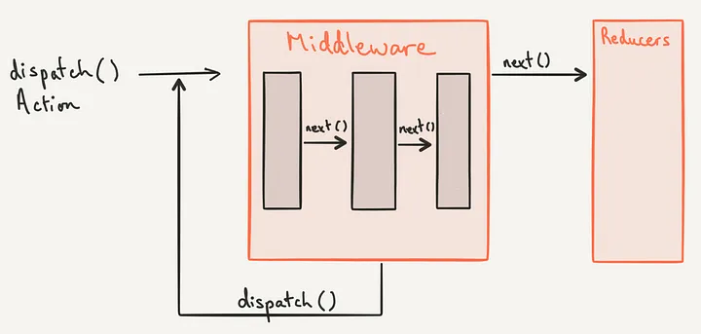
How middleware works

Slide 19
Redux Thunk Gives Redux Side-Effects
In redux , actions creators are functions that return an action, which is a plain javascript objects with a type property. redux-thunk is a Redux Middleware that lets your action creators return a function called a thunk, instead of an action. This thunk can return an action when invoked but it also has access to the Redux store's dispatch function, meaning it can also dispatch other actions. Typically, API calls are invoked inside these thunks and different actions are dispatched depending on these API responses.For example, below are two action creators, the first returns a plain redux action. The second returns a thunk, thanks to redux-thunk .

Slide 20
// action creators
 | // Action Creator returns action
 | loadUser = (userData) => ({
 | type: "LOAD_USER_DATA", userData
 | })
 | /*
 | Action Creator which returns function which dispatches other actions
 | */
 | fetchUser = (usersUrl) => (dispatch) => {
 | dispatch({ type: "DISPLAY_LOADING_SCREEN" })
 | return fetch(usersUrl)
 | .then(response => response.json())
 | .then((json) => {
 | if (json.success) {
 | dispatch({ type: "LOAD_USER_DATA", json.userData })
 | } else {
 | dispatch({ type: "LOAD_USER_FAILED" })
 | }
 | })
 | }

